Slide 1
ZOMBIE HUNTERS Data Collection
Audrey
Dawn
Deanne

Slide 2
Deliverable 1 (placeholder)
1 Research Phase = How do you intend to gain empathy and context?

Slide 3
Data Collection Teams
Who are the data collectors?
Teams of 3
Trained for combat
Courageous men and women
What do they do?
Travel to all infected regions
Find zombies dead or alive
Collect blood samples from them
Where do they work?
In any environment where there are zombies
Major cities, small towns and the countryside
Why do they do it?
Everybody has lost someone they love to zombies
Stop the zombie epidemic
Need to find patient 0
To help all of mankind
Notes:
Who – Teams are made up of three courageous men and women that are quickly trained for combat. They are willing to go anywhere and do anything to get the job done.
What – They look for zombies both dead and alive to collect blood samples from them.
Where – The teams travel everywhere and anywhere they can find zombies. They scour major cities, small towns and the countryside.
Why – Everybody has lost someone they love to zombies so most of them take this very personally. They have a strong desire to find patient 0 with the hope of stopping the zombie epidemic to save all of mankind.

Slide 4
Everyday Life in the Field
Followed a team for 3 days to observe
The environment they work in
What they do
How do they collect the data
What risks do they take
What precautions are needed
What equipment is used
Notes:
Context = the circumstances that form the setting for an event, statement, or idea, and in terms of which it can be fully understood and assessed.
Findings: Teams work under harsh conditions and have to deal with both natural and supernatural elements. Before heading out, they have a predetermined destination in mind where there are either areas that have not been sampled, need more samples or an area of interest that needs further evaluations. They drive around in armored vehicles in the designated area looking for zombies.
All the duties are shared among the team members.

Slide 5
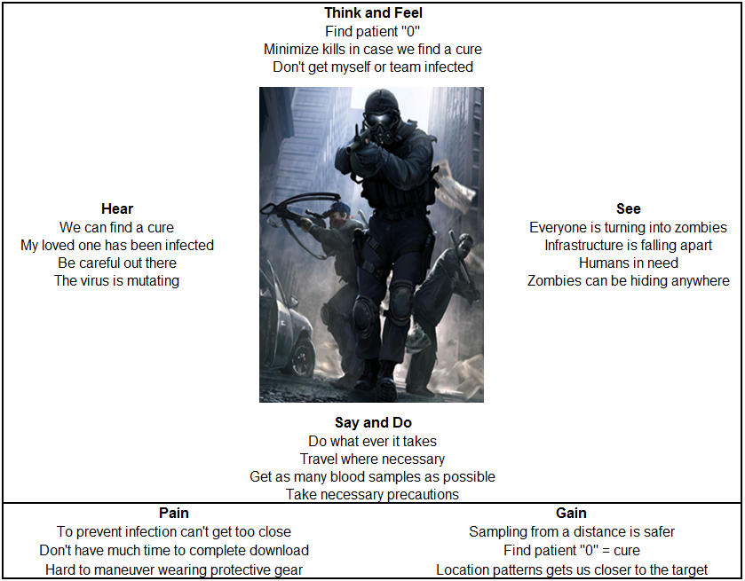
Empathy Map
Notes:
Think - Our goal is to find patient 0 to find a cure. We don’t necessarily want to kill zombies unless we have to because we WILL find a cure. We also don’t want to get ourselves infected.
Hear - The CDC tells us that they are working on a cure and the more samples they get the closer they get. We hear sob stories everyday from people who have lost loved ones to this virus. We are being told that we are appreciated for what we do and to be careful while we are doing it. The CDC has informed us that the virus is mutating.
See - We see zombies everywhere. It seems like there are more zombies than live people. The infrastructure is falling apart around us. Buildings are in disrepair, abandoned cars are blocking the roadways and communication is spotty.
Say - We will do what ever it takes and go wherever we need to in order to get a good variety of samples. We will work long hours under any condition to obtain as many samples as we can. We will be careful and take all the necessary precautions.
Pain - We don’t want to infect ourselves so we don’t want to get too close in order to obtain a sample. There is not much time to get a sample because we can very easily get overcome by multiple zombies. We need to have some type of protective gear and it makes it hard at times to maneuver. So we use the best gear available that has the least hindrance.
Gain - Getting samples from a distance makes it safer for the team to work. Our goal is to find patient 0 so a cure can be found. Using location patterns of different strains gets us closer to our target.

Slide 6
Deliverable 2 (placeholder)
2 Prototyping = Phase What assumptions have you made?
Notes:
Dart gun: just a tool to get the dart to target
Darts: sensors to analyze blood, location, break of tip with locator chip inside (to track migration for future analysis). Bluetooth – 30 feet. Need to pair. Download info to phone then upload later.
Analyze blood to determine: gender, blood type, strain or new mutation
Use GPS locator, if not available manually enter
Database to store samples: analyze location of different strains to determine where more samples are needed.
Solar to charge batteries
Indicators:
911
Upload complete

Slide 7
Deliverable 3 (placeholder)
3 User Testing Phase = How do you define success?
Notes:
Test the maximum distance to receive data transmission.
Test microchip that transmits location
Test blood analysis returns correct blood type, gender and strain or new mutaion.
Test upload to main database
Battery life

Slide 8
Deliverable 4 (placeholder)
4 Wireframes = Show me what you mean.

